Slide 1
Mob hub
Developed using android studio
2023-2024
~ SAMREEN FATHIMA M
BCA COMPUTER SCIENCE
BATCH – “B”

Slide 2
PROJECT ABSTRACT
The "Mob Hub" is a mobile application designed to provide users with a convenient and efficient platform for exploring, purchasing, and managing a wide range of accessories for their mobile devices. The app aims to enhance the overall mobile experience by offering a diverse selection of high-quality accessories such as cases, chargers, headphones, screen protectors, and more. The Mob Hub aims to create a one-stop-shop for mobile users, offering not only a vast selection of accessories but also an enriching and personalized shopping experience. Through a blend of user-friendly design and robust features, the app strives to become an indispensable companion for mobile enthusiasts seeking to enhance and customize their devices. The app aims to enhance the shopping experience for mobile accessory enthusiasts by offering a seamless and personalized platform accessible through mobile devices, allowing users to explore and shop for their favorite accessories anytime and anywhere.
The project involves developing a mobile accessories app using java.

Slide 3
PROJECT INTRODUCTION
The dynamic world of mobile technology, the importance of accessories to complement and enhance the functionality of our devices cannot be overstated. Mobile accessories have evolved from mere add-ons to essential companions, offering users a personalized and optimized experience with their smartphones and tablets. From protective cases and stylish covers to advanced chargers and cutting-edge audio devices, mobile accessories have become an integral part of our daily lives. As mobile devices continue to evolve, so too will the landscape of mobile accessories. The synergy between advancements in technology and the creativity of accessory manufacturers ensures that users can tailor their devices to meet their unique needs and preferences. The world of mobile accessories is not just about functionality; it's a canvas for personal expression and a testament to the ever-expanding possibilities within the realm of mobile technology.

Slide 4
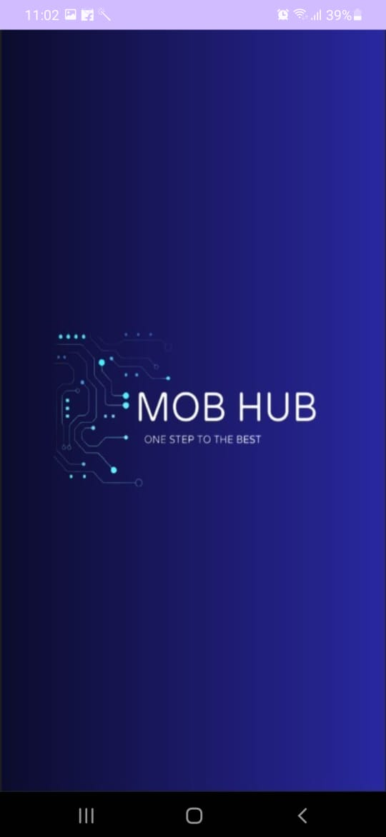
SPLASH SCREEN
PLATFORM USED-ANDRIOD STUDIO
-utilizing Java as the primary programming language to make to screen stay for 2000ms
-XML- for designing the user interface.

Slide 5
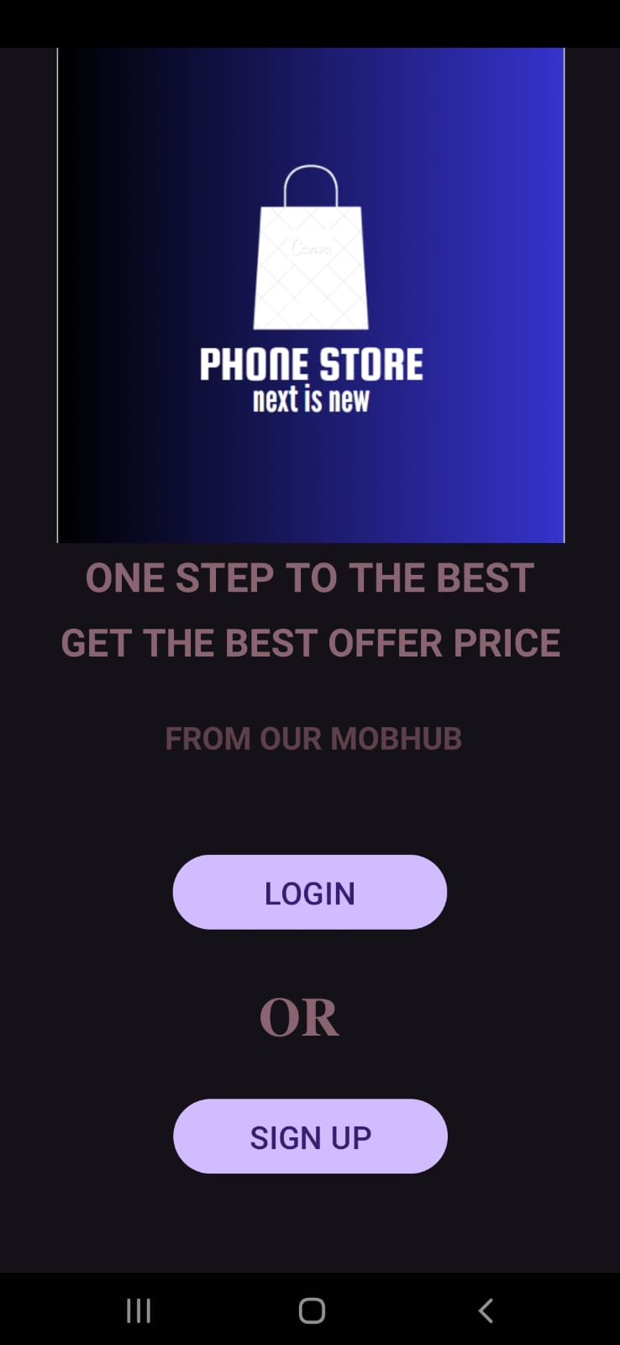
2. WELCOME SCREEN
PLATFORM USED-ANDRIOD STUDIO
The second screen of the app features a welcoming interface prompting users to either sign up if they are new or log in if they are existing users. The screen is designed using XML layout in Android Studio, incorporating intuitive buttons.

Slide 6
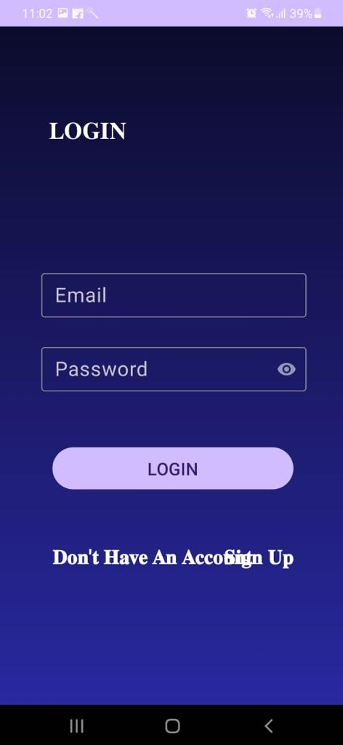
LOGIN SCREEN
The screen is designed using XML layout in Android Studio, incorporating intuitive buttons and input fields for email and password. The signup/login functionality is implemented using Firebase Authentication

Slide 7
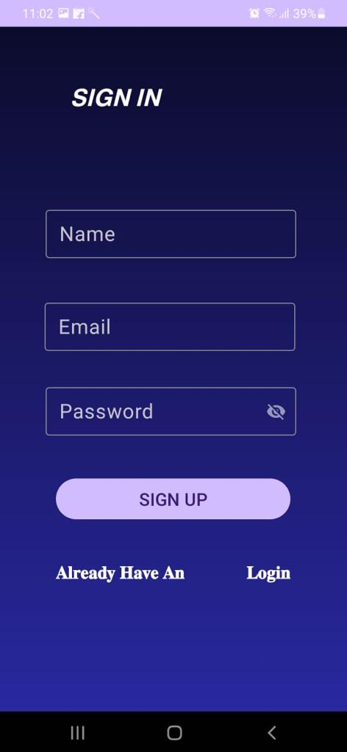
SIGNUP SCREEN
The screen is designed using XML layout in Android Studio, incorporating intuitive buttons and input fields for username, email and password. validation are included to ensure accurate user input.

Slide 8
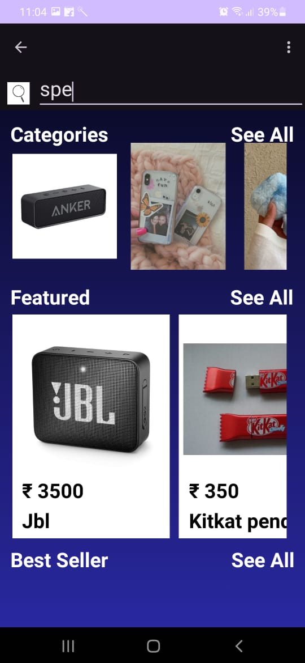
HOME SCREEN
The home screen of the app is designed with a user-friendly interface, featuring three main sections:
CATEGORY:
Each category is clickable, leading users to explore brands within their area of interest.
FEATURED:
These features are implemented using Recycler Views and custom adapters to display dynamic content efficiently.
BESTSELLER:
This section helps users discover trending items quickly. Product data is fetched from a backend database (such as Firebase Realtime Database or API calls) and displayed using appropriate layouts and designs.

Slide 9
6. SEARCH IMPLEMENTATION
Search-Functionality: Implement search functionality using Edit Text listeners or Search View widget. As the user types, filter the product list based on the search query and update the Recycler View adapter accordingly.

Slide 10
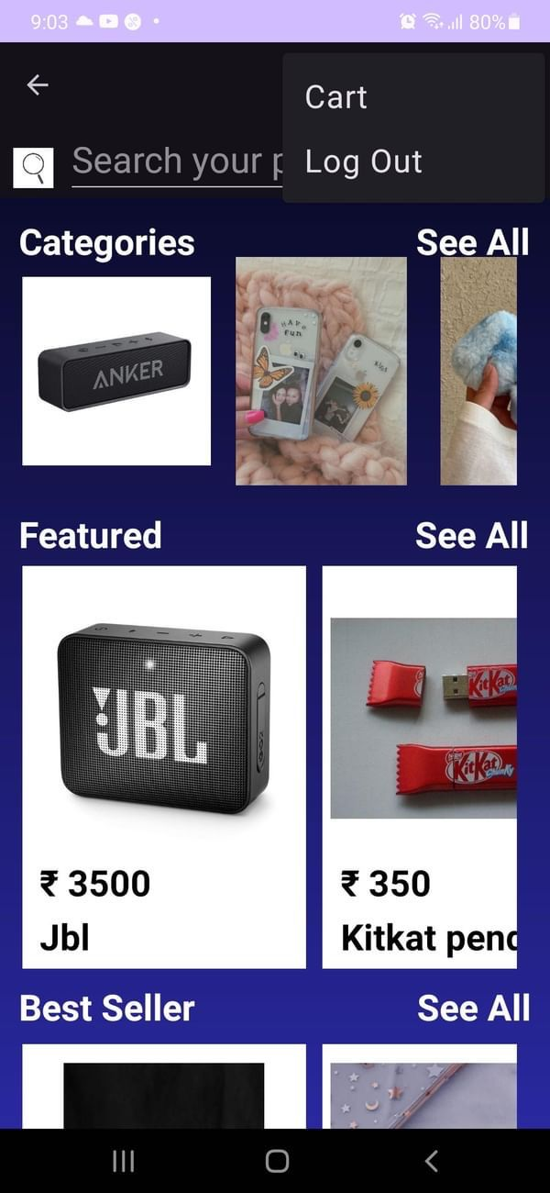
7. MENU
We have two Menu options:
1) Cart
2) Log Out
1. CART IMPLEMENTATION:
Data Model: Define a data model for products including attributes like name, price, quantity, etc. Implement a data structure to manage the cart items.
Add to Cart: Implement functionality to add products to the cart. This could be triggered by a button click on the product item in the Recycler View.
2. LOG OUT:
The logout button is used for securely ending your current session, thereby ensuring the privacy and security of your account.

Slide 11
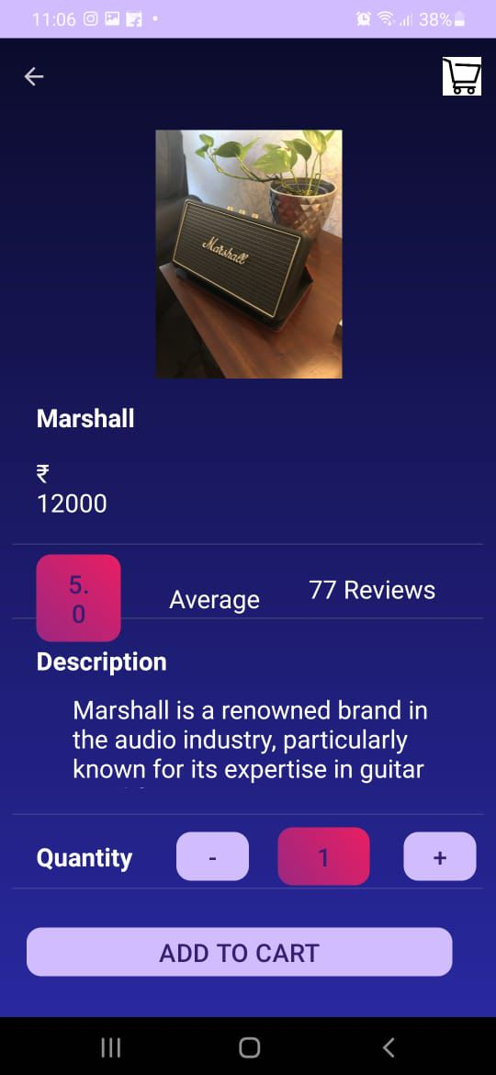
8. PRODUCT DETAILS
Layout Design: the cart activity layout is designed using XML, including Image View for product image, Text Views for product details (rating, quantity, description), and a button for adding to cart.
Data Passing: Pass product data (image URL, rating, quantity, description) from the previous activity (e.g., home screen) to the cart activity using Intent extras or a shared View Model.
Add to Cart Button: Implement onClickListener for the "Add to Cart" button. On click, add the product to the cart data structure (e.g., ArrayList) or update the cart in a database (local or remote).
Navigation: After adding to cart, navigate the user back to the previous screen or to a dedicated cart view.

Slide 12
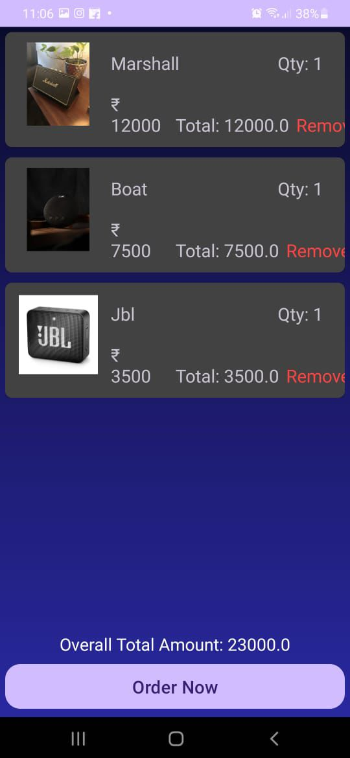
9. ORDER PLACEMENT
Order Summary: Show a summary section displaying total order amount, taxes (if applicable), and any additional charges like shipping fees.
Order Placement: Implement onClickListener for the “ORDER NOW“ button. Validate user inputs, process payment and navigates the screen to the next screen for processing the payment

Slide 13
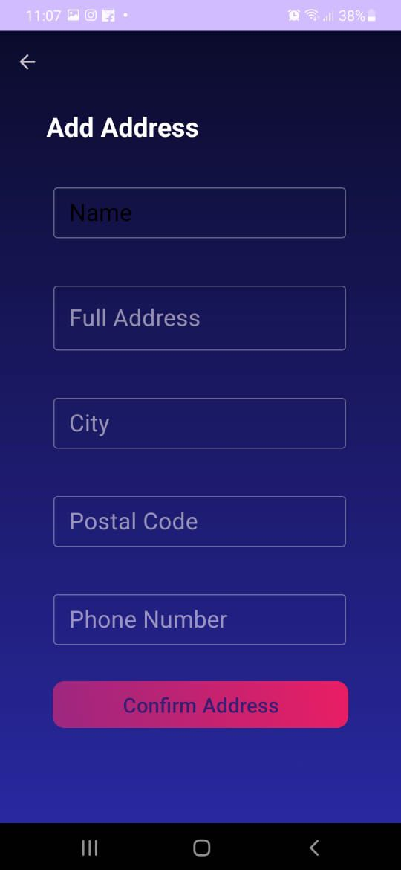
10. ADDRESS DETAILS
The "Add Address" screen in the app is a crucial step that enables users to input their accurate address details for seamless payment processing.
Users can enter their Name, Full address, city, postal/zip code, and phone number to ensure the delivery of their purchases to the correct location.
Once the address details are entered and saved, users can proceed confidently to the payment stage, knowing that their purchases will be shipped to the correct destination.
The "Confirm Address" button on the Add Address screen verifies and validates the entered address details for accuracy and completeness.
Upon clicking this button, users are smoothly redirected to the next screen in the payment process, ensuring a seamless transition and accurate delivery information for their purchases.

Slide 14
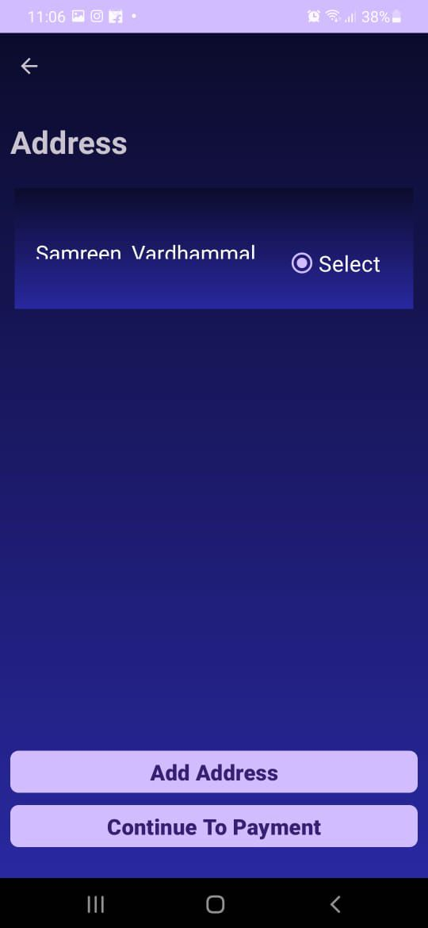
11. PROCEEDING TO PAYMET
1.After successful verification, users are seamlessly redirected to the next screen in the payment process, such as selecting a payment method or entering billing details.
2.This workflow ensures that users proceed through the payment process with confidence, knowing that their shipping address is accurately confirmed for delivery.

Slide 15
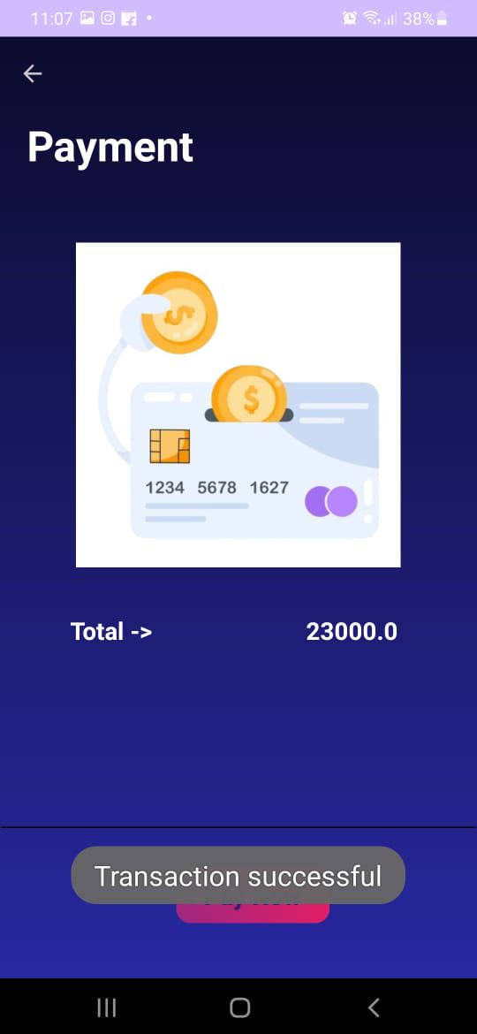
12. TRANSACTION-PAYMENT
1. After clicking "Pay Now," users are promptly notified with a "Transaction Successful" message, confirming that the payment has been processed without issues.
2. This final screen provides users with immediate feedback, ensuring a seamless and reassuring experience as they complete their transactions.

